Slide 1
Oxygen: Basic Concepts
Dr N Chandra Kumar
Consultant Neonatologist
Cloud Nine Hospital
Chennai

Slide 2
Objectives
What is oxygen? What is its role in body function?
How is oxygen transported in the body?
What is hypoxia and hyperoxia?
What are the harms / potential toxicities of hypoxia and hyperoxia?

Slide 3
Oxygen
Oxygen, expressed as O₂, is a colorless, odorless gas
Oxygen is available to us from atmospheric air
Normal concentration in air- 21%
O₂ is absorbed in to our body from the air we breathe in

Slide 4
Oxygen- its role in normal body function
Essential for functioning of each and every cell of the body
Energy synthesis (ATP)- cellular respiration
This energy is required for normal functioning of the cell
  Synthesis of structural proteins
  Synthesis of functional proteins
  Other metabolic reactions
Lack of oxygen- depletion of energy- CELL DEATH

Slide 5
Oxygen transport in the body
Heart
O2
Peripheral capillary
O2
O2
O2
Pulmonary capillary
Lung
O2
Peripheral tissues

Slide 6
Oxygenation- How to measure?
Oxygen delivered is expressed as FiO2
Oxygen is transported
  Bound to Hemoglobin
  As dissolved oxygen
Oxygenation can be expressed as
  PaO₂ (partial pressure of oxygen)- Pressure exerted by dissolved oxygen
  SpO₂ (% saturation of oxygen)-% of Hb totally bound to oxygen

Slide 7
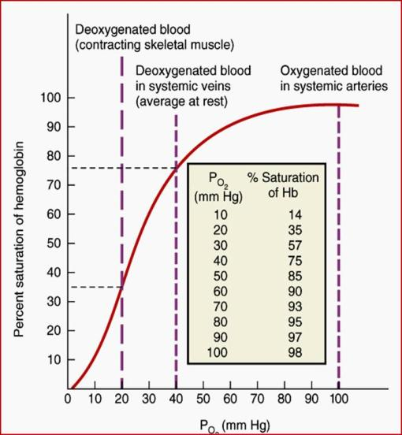
Relation between PO₂ & SpO₂
PaO₂ (mmHg) | SpO₂ (%)
27 | 50
50 | 85
70 | 95

Slide 8
Hypoxia & Hyperoxia
Hypoxia and hyperoxia are terms used to describe low or high levels of oxygen
Based on PaO₂:
  Normal PaO₂: 50-70 mm Hg
  Hypoxia: PO₂ <50 mmHg from arterial blood sample
  Hyperoxia: PO₂ >70 mmHg
Based on SpO₂:
  Normal saturation targets: 90-95%
  Hypoxia: <90%
  Hyperoxia: >95%

Slide 9
Effects of Hypoxia
Acute hypoxia
Lethargy, poor activity, unconciousness
Bradycardia, shock
Recurrent hypoxia
↑ risk of death
↑ Periventricular Leukomalacia
Decreased urine output
Pallor
↑ Necrotizing enterocolitis
Pulmonary hypertension

Slide 10
Effects of Hyperoxia
Hyperoxia
Retinopathy of prematurity
Aggravates post-asphyxial brain injury
Bronchopulmonary dysplasia
Necrotising enterocolitis

Slide 11
Monitoring oxygen status
Clinical identification- Not possible
Continuous monitoring with pulse-oximeter is essential
At higher oxygen saturation ranges SpO₂ is not reliable – fails to detect hyperoxia
Desired oxygen saturation target is 90-95%

Slide 12
Key messages…
Oxygen is essential for normal function of the body
Both hypoxia and hyperoxia are harmful to preterm babies
Monitoring by pulseoximetry is essential
Maintaining optimal oxygen saturation targets is essential to prevent harmful effects of hypoxia or hyperoxia

Slide 13
Thank You

